Slide 1
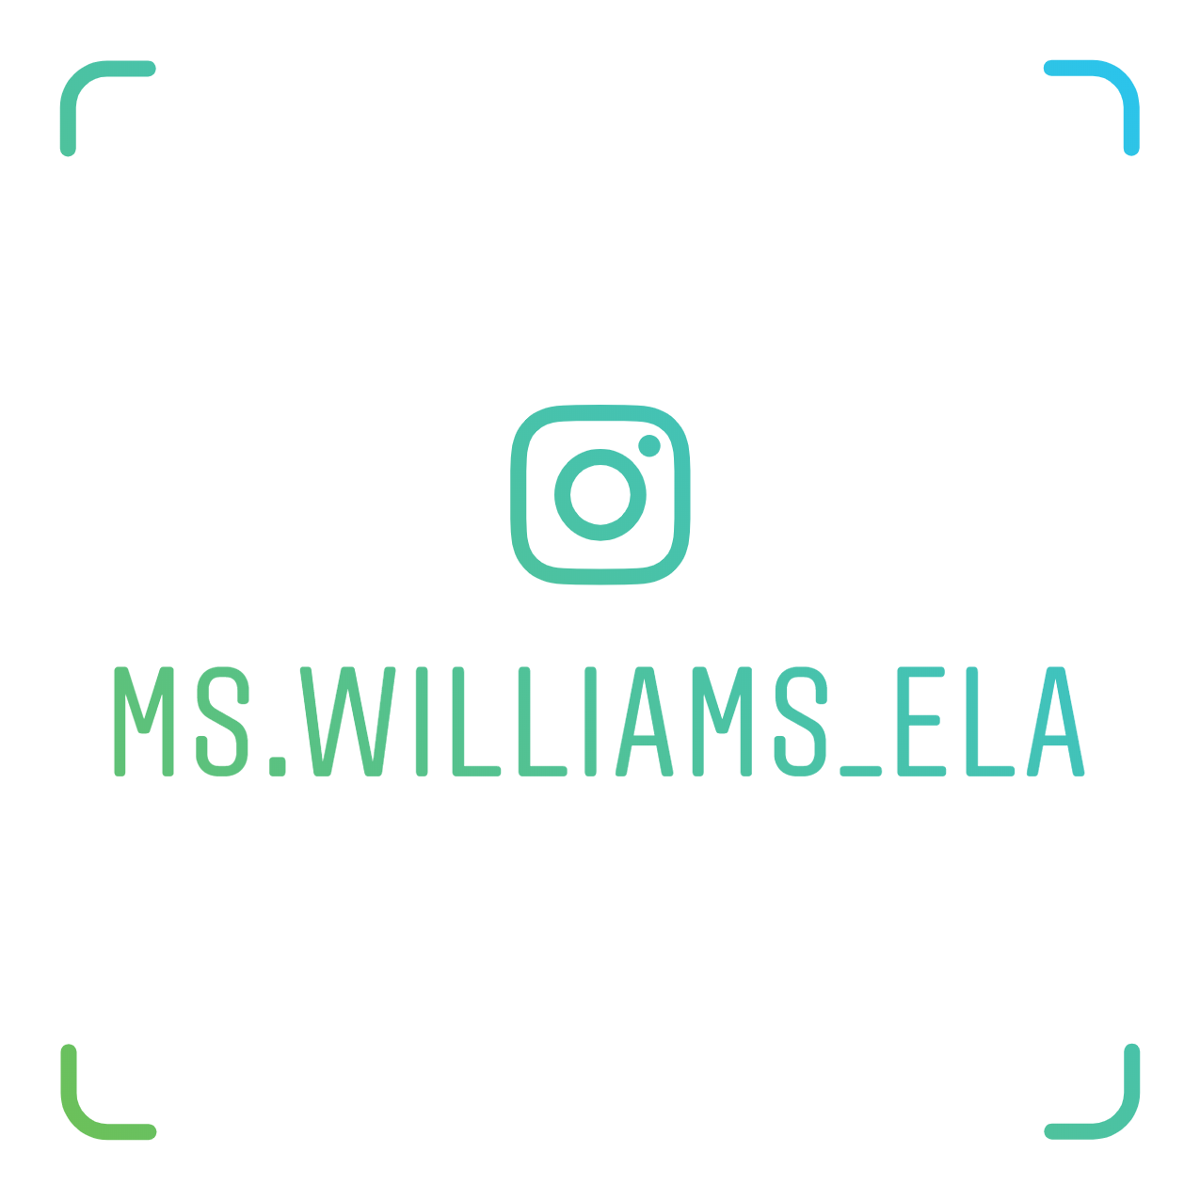
Welcome to 6th grade ELA
Ms. Williams
Email: williaj12@gcsnc.com
School number: 336-378-8250 ext. 1652
Cell number:3369-901-0103

Slide 2
What to Expect
Four Units
Launch Unit
Space Unit
Adventure Unit
Environmental Studies Unit
Daily reading, writing, talking, and thinking
Homework

